Slide 1


Social Buzz’s
Data Analysis

Slide 2


Today's agenda
Project recap
Problem
The Analytics team
Process
Insights
Summary

Slide 3

Social Buzz is a fast growing technology unicorn that need to adapt quickly to it’s global scale. Accenture has begun a 3 month PO focusing on these tasks:
An audit of Social Buzz’s big data practice
Recommendations for a successful IPO
Analysis to find Social Buzz’s top 5 most popular categories of content
Project Recap

Slide 4

Problem
Over 100000 posts per day
36,500,000 pieces of content per year!
But how to capitalize on it when there is so much?
Analysis to find Social Buzz’s Top 5 most popular categories of content

Slide 5



Marcus Rompton
Senior Princile
The Analytics team
Andrew Fleming
Chief Technical Architect
Deepesh
Data Analyst

Slide 6
Process
1
Data Understanding
2
Data Cleaning
3
Data Modelling
4
Data Analysis
5
Uncover Insights

Slide 7

Insights
16
1897
May
UNIQUE CATEGORIES
REACTION TO ANIMALS
MONTH WITH MOST POSTS

Slide 8
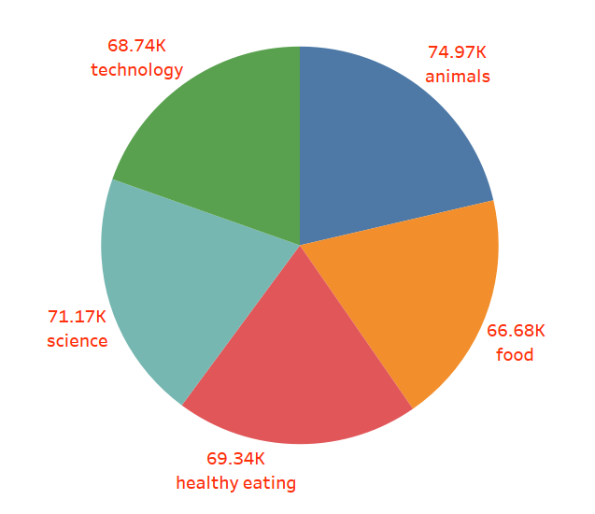
Top 5 Category by Popularity Score

Slide 9
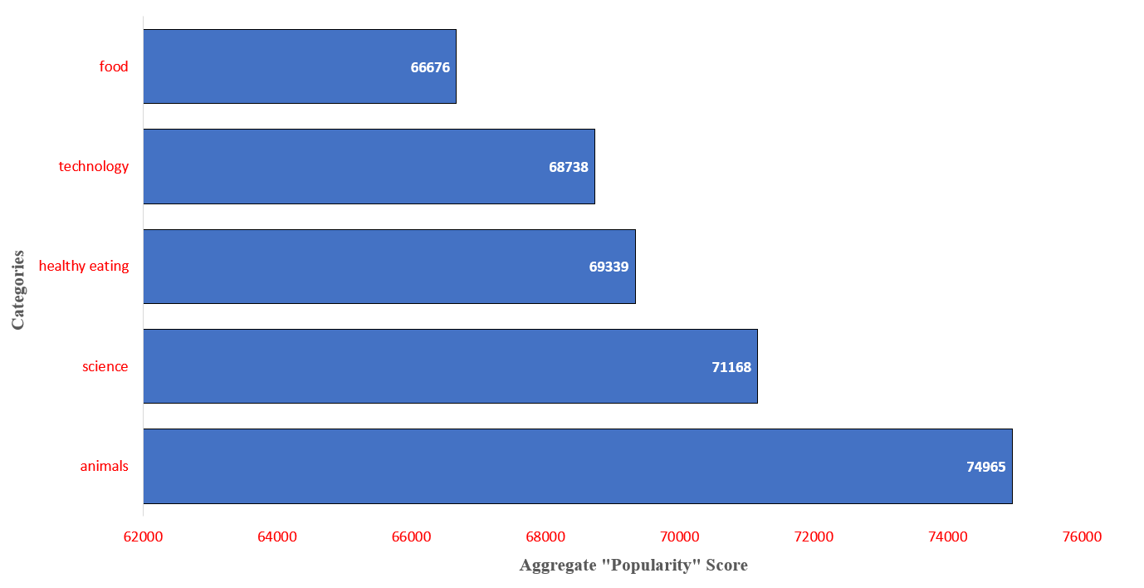
Top 5 Categories by Aggregate “Popularity” Score

Slide 10

Analysis
Animals and Science are the two most popular content categories, indicating that consumers prefer “real-life” and “factual” information.
Insights
Summary
Food is a recurring topics in the top five categories, with “Healthy Eating” rating highest. This may provide and insight to you user base’s audience You might utilize this information to develop a campaign and collaborate with healthy eating brands to increase user engagement
Next Steps
This ad hoc analysis is enlightening, but it’s time to scale it up for real-time understanding of your business. We can show you how to do it.

Slide 11
Thank you!
ANY QUESTIONS?

